Slide 1
Thesis update
Susan van de Sande

Slide 2
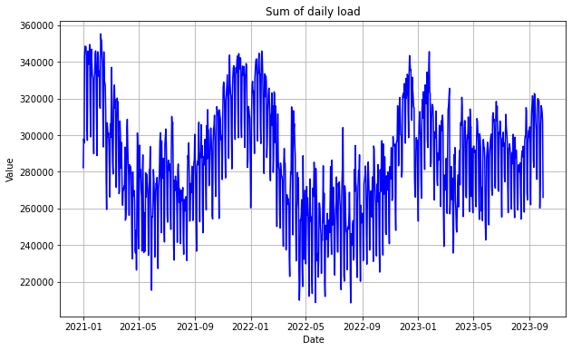
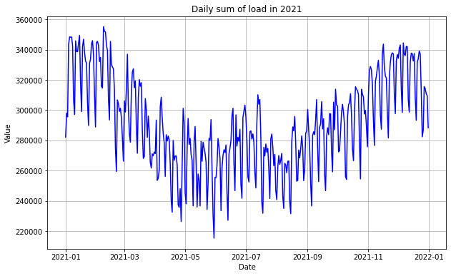
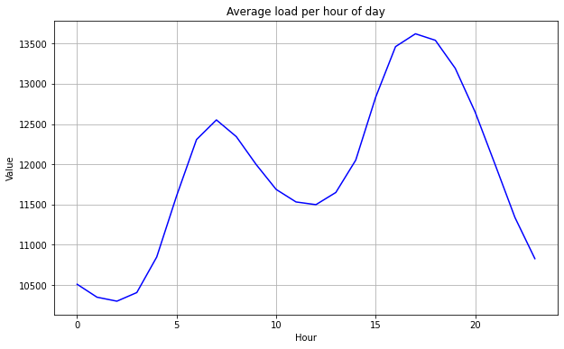
New data set: hourly load from ENTSO-E
Total
Single year
Single day

Slide 3
Climate change features
Climate change effects in NL according to Rijksoverheid:
More rain
Heavier storms
Long drier and hot periods

